Slide 1
Safe regression test selection for Modelica
By Erik Hedblom and Kasper Rundquist
Notes:
Presentera oss och projektet

Slide 2
Goal
Problem
Running tests for Modelica projects takes a long time
Goal
Reduce test times for Modelica projects in a safe way
Notes:
Animera fram Solution
Berätta om modelica, exempel, osv,
Förklara vad safe betyder = ej missa test-fel

Slide 3
Goal
Problem
Running tests for Modelica projects takes a long time
Goal
Reduce test times for Modelica projects in a safe way
Solution
Safe test selection
Selecting a subset of all tests
Using static analysis
Notes:
Animera fram Solution
Berätta om modelica, exempel, osv,
Förklara vad safe betyder

Slide 4
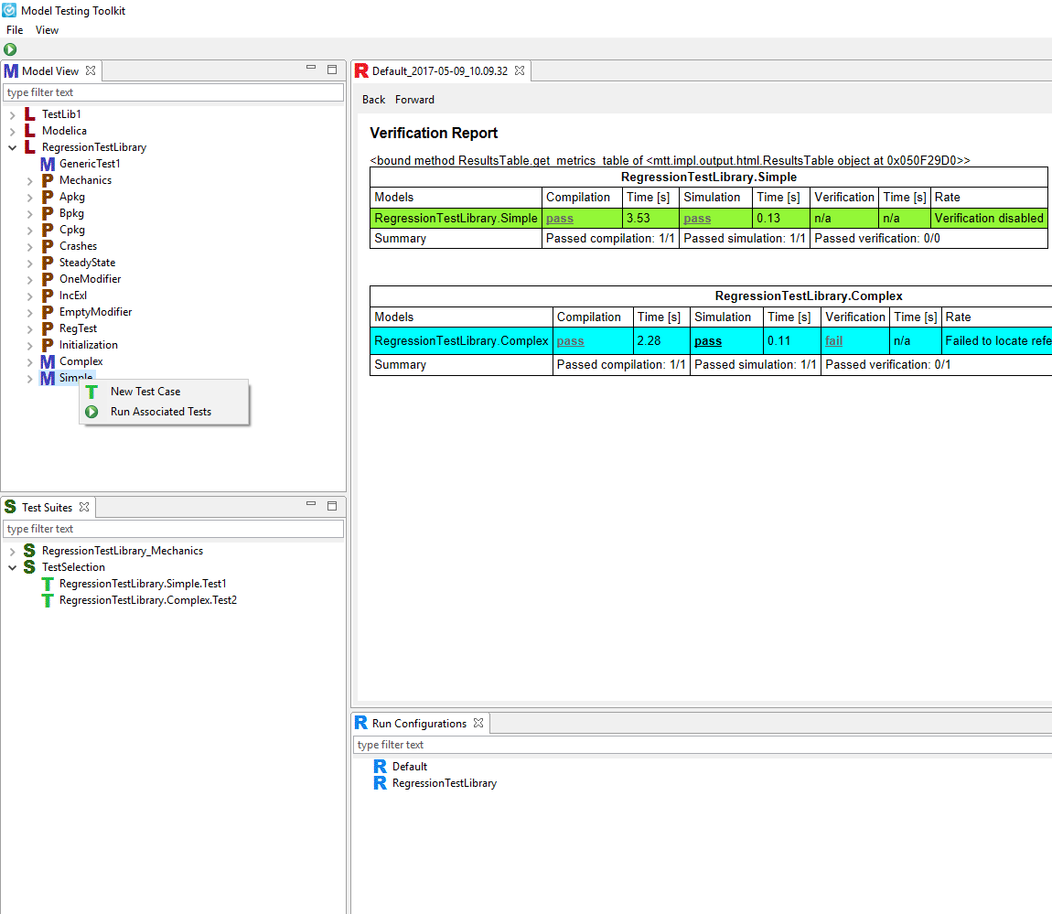
Results: test selection implemented in Model Testing Toolkit
Notes:
External functions
Change detection

Slide 5
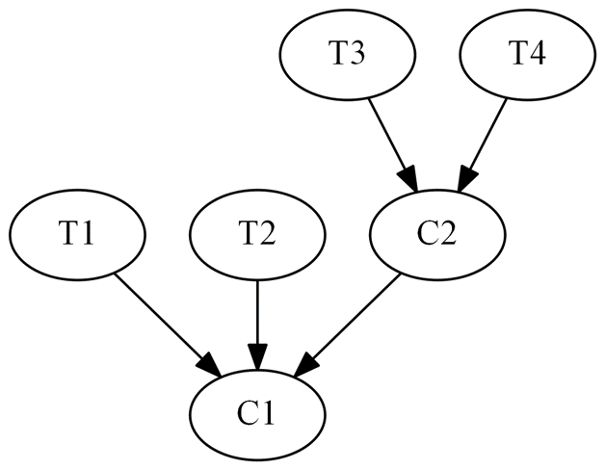
Safe test selection
Select tests based on how tests depend on classes
Tests: T1, T2, T3, T4 Classes: C1, C2
Dependency graph
Notes:
Safe: garantera att alla tester som skulle kunna misslyckas faktiskt körs
Naiv metod: kör alla tester
Lång tid att köra alla tester
Ge exempel: om man ändrar C1 så får man köra XXX, ... Om man ändrar C2 så får man köra YYY

Slide 6
Simplified Dependency Rules
A class depends on all classes referenced by accesses within.
A class depends on its enclosing class.
A class depends on all classes referenced by access paths within it.
A class depends on all classes enclosed by an accessed class.
Exception to Rule 4: Rule 4 is not applicable to import statements.
Rule 4 and 5 are needed due to limitations in the compilation stage the solution is implemented in.
Notes:
Vi har utvecklat 5(4) regler för att skapa en beroende graf.

Slide 7
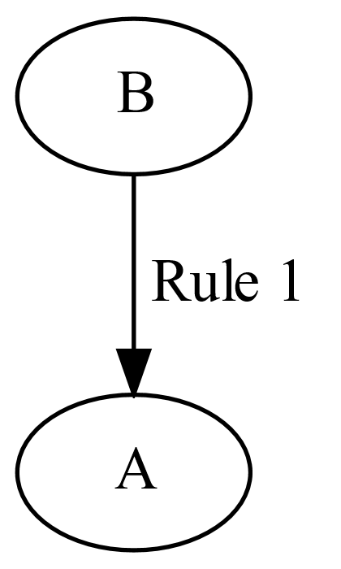
Dependency rule 1
1. A class depends on all classes referenced by accesses within.
model A
end A;
model B
A a;
end B;
Notes:
Beskriv regel 1
Visa att vi inte kan slå upp m1.k1 till höger
Säg något om namnuppslagning

Slide 8
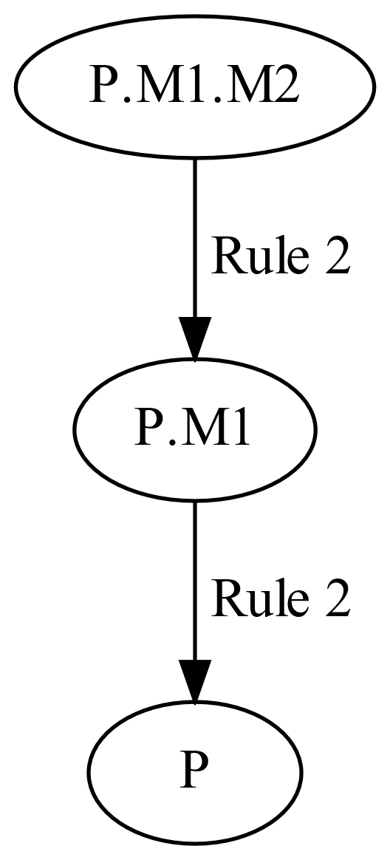
Dependency rule 2
2. A class depends on its enclosing class.
package P
constant Real k = 1;
model M1
model M2
Real x = k;
end M2;
end M1;
end P;
Notes:
Regel 2

Slide 9
Dependency rule 2
2. A class depends on its enclosing class.
package P
constant Real k = 1;
model M1
model M2
Real x = k;
end M2;
end M1;
end P;
If we add k in M1 too?
Notes:
Regel 2

Slide 10
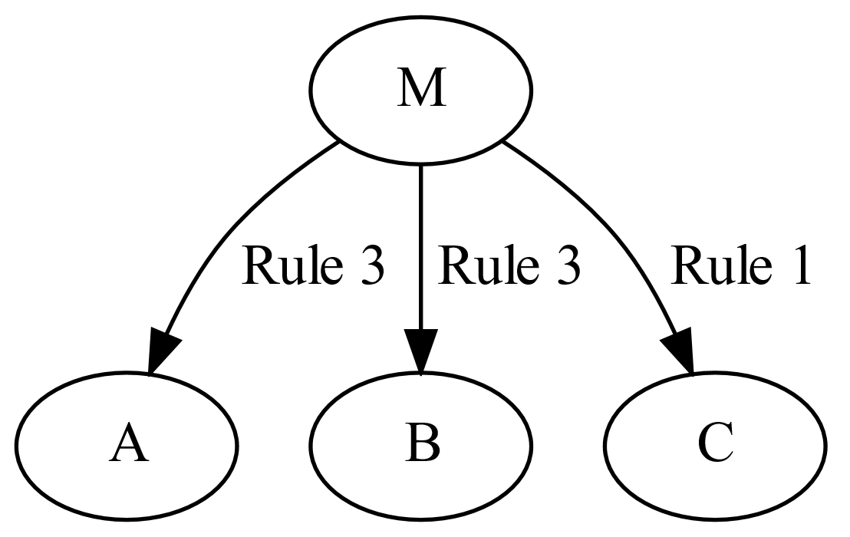
Dependency rule 3
3. A class depends on all classes referenced by access paths within it.
model M
A.B.C c;
end B;

Slide 11
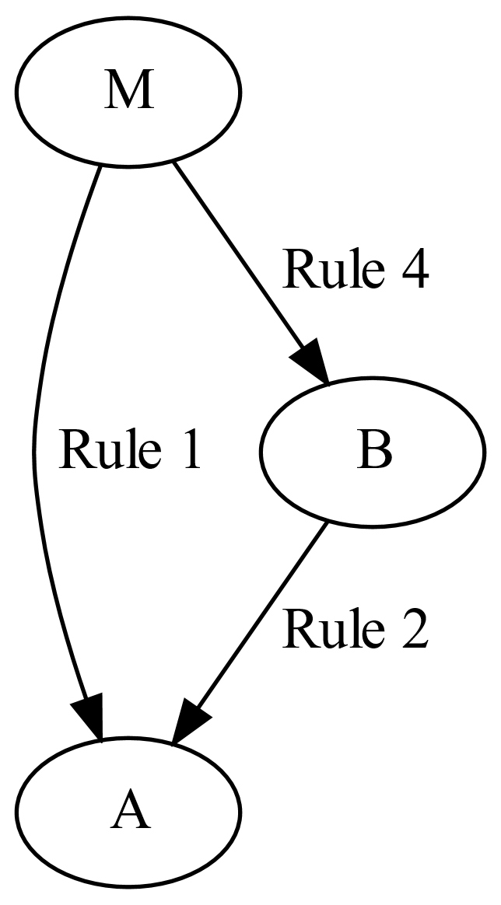
Dependency rule 4
4. A class depends on all classes enclosed by an accessed class.
model M
A a;
end M;
model A
model B
end B;
end A;

Slide 12
Evaluation
Evaluated in two ways:
One file is changed
Measured for all files
Commit history for changed files

Slide 13
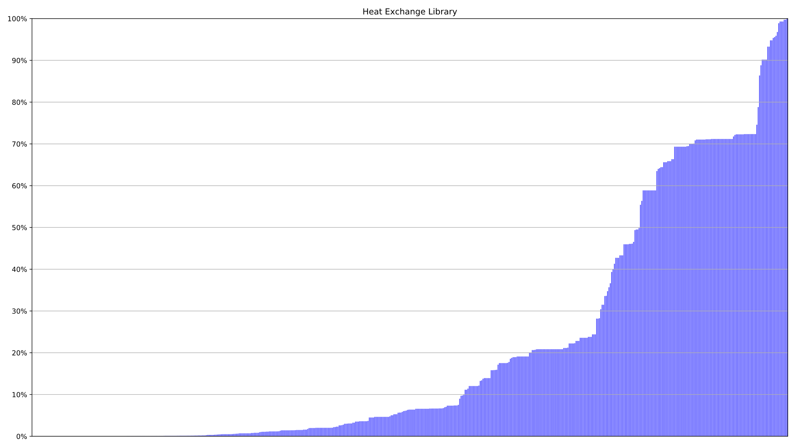
One file – Heat Exchange Library
68% time saved in average!
Time
File

Slide 14
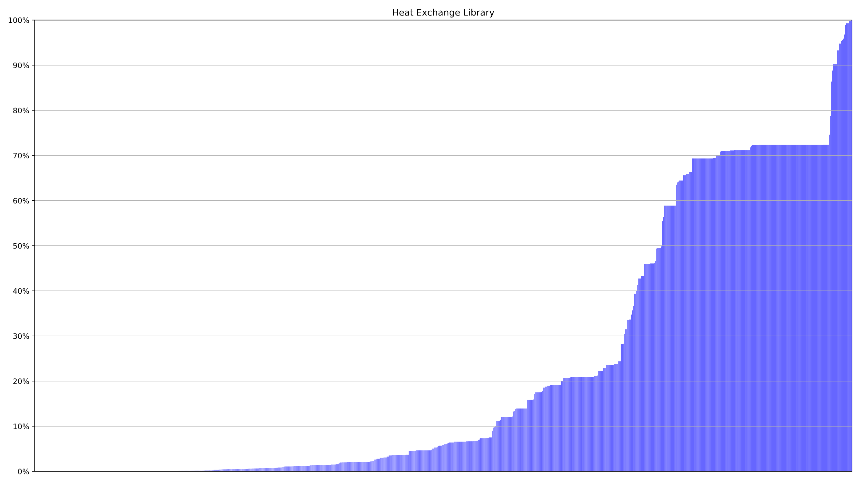
One class – Heat Exchange Library
67% time saved in average!
Time
Class

Slide 15
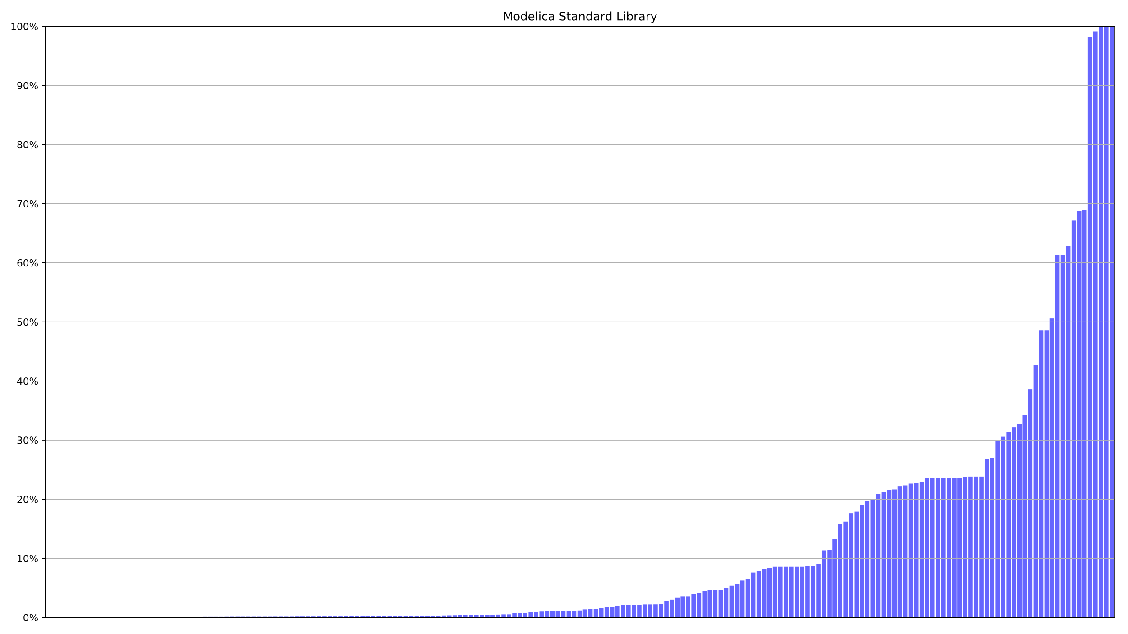
One file – Modelica Standard Library
88% time saved in average!
Time
File

Slide 16
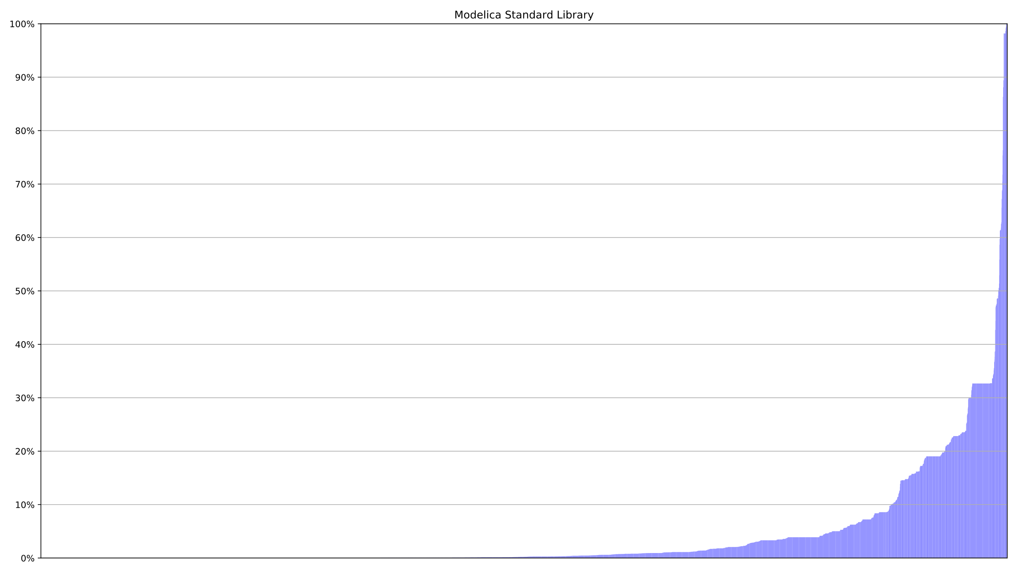
One class – Modelica Standard Library
93% time saved in average!
Time
Class

Slide 17
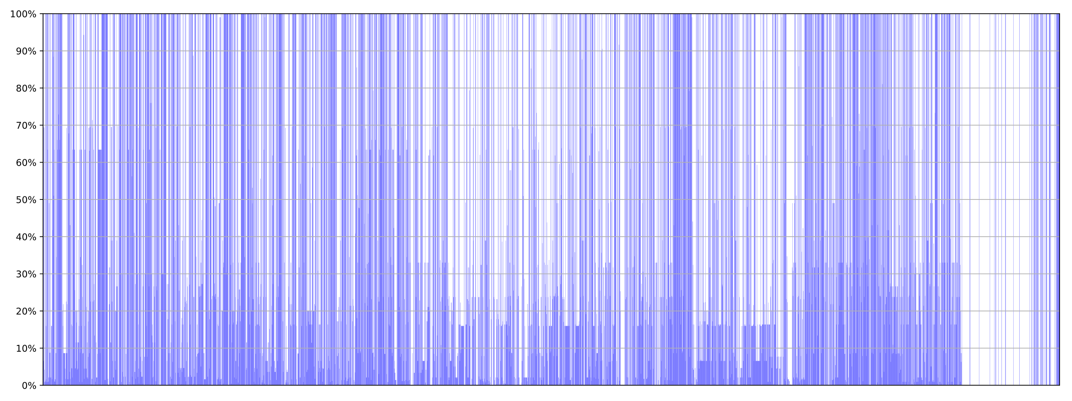
Commit history – Modelica Standard Library
56% time saved in average!
Time
File
Notes:
Beskriv grafen, ett mer realistiskt användingsfall
En approximation
Vi har inte kört om analysen för varje kommit
Inkluderar inte analys tiden

Slide 18
Evaluation
 | Units | Complete testsuite execution time | Dependency analysis exectution time | Average time savings
HXL | 552 files | 3h 1m 51s | 6.7s | 68%
 | 819 classes |  |  | 67%
MSL | 197 files | 2h 26m 36s | 18.8s | 88%
 | 5917 classes |  |  | 93%
 | 4341 commits |  |  | 56%
Notes:
Sammanfatta våra resultat

Slide 19
Conclusion
Conclusion
Dependency rules
Implemented
Time savings
Future work
Run testselection in paralell with complete testsuite
Mutation testing
Create dependency graph in later compilation phase (instance tree)
Notes:
Validering
Vi har utvecklat en test svit, delvis genom att köra analysen på MSL och manuellt jämföra resultatet
Vi har kontinuerligt under arbetets gång diskuterat vår analys med Jesper och Jonathan på Modelon.
Future work
More validation
Instance tree – varför?

Slide 20
Questions?

Slide 21
Dependency rule 1
1. A class depends on all classes referenced by resolvable accesses within it.
package P
model M1
constant k1 = 0;
end M1;
model M2
M1 m1;
end M2;
end P;
package P
model M1
constant k1 = 0;
end M1;
model M2
M1 m1;
constant k2 = m1.k1;
end M2;
end P;
Notes:
Beskriv regel 1
Visa att vi inte kan slå upp m1.k1 till höger
Säg något om namnuppslagning

Slide 22
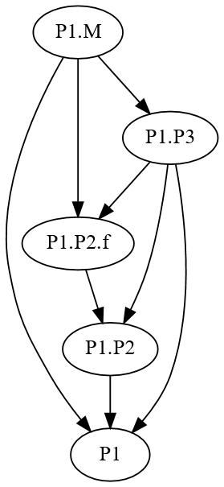
Dependency rule 3
3. A class depends on all classes referenced by access paths within it. A unresolvable access can still contain resolvable accesses within its path.
package P1
package P2
function f
input Real x;
output Real y;
algorithm
y := x;
end f;
end P2;
package P3
extends P2;
end P3
model M
Real x = P3.f(0);
end M;
end P1;

Slide 23
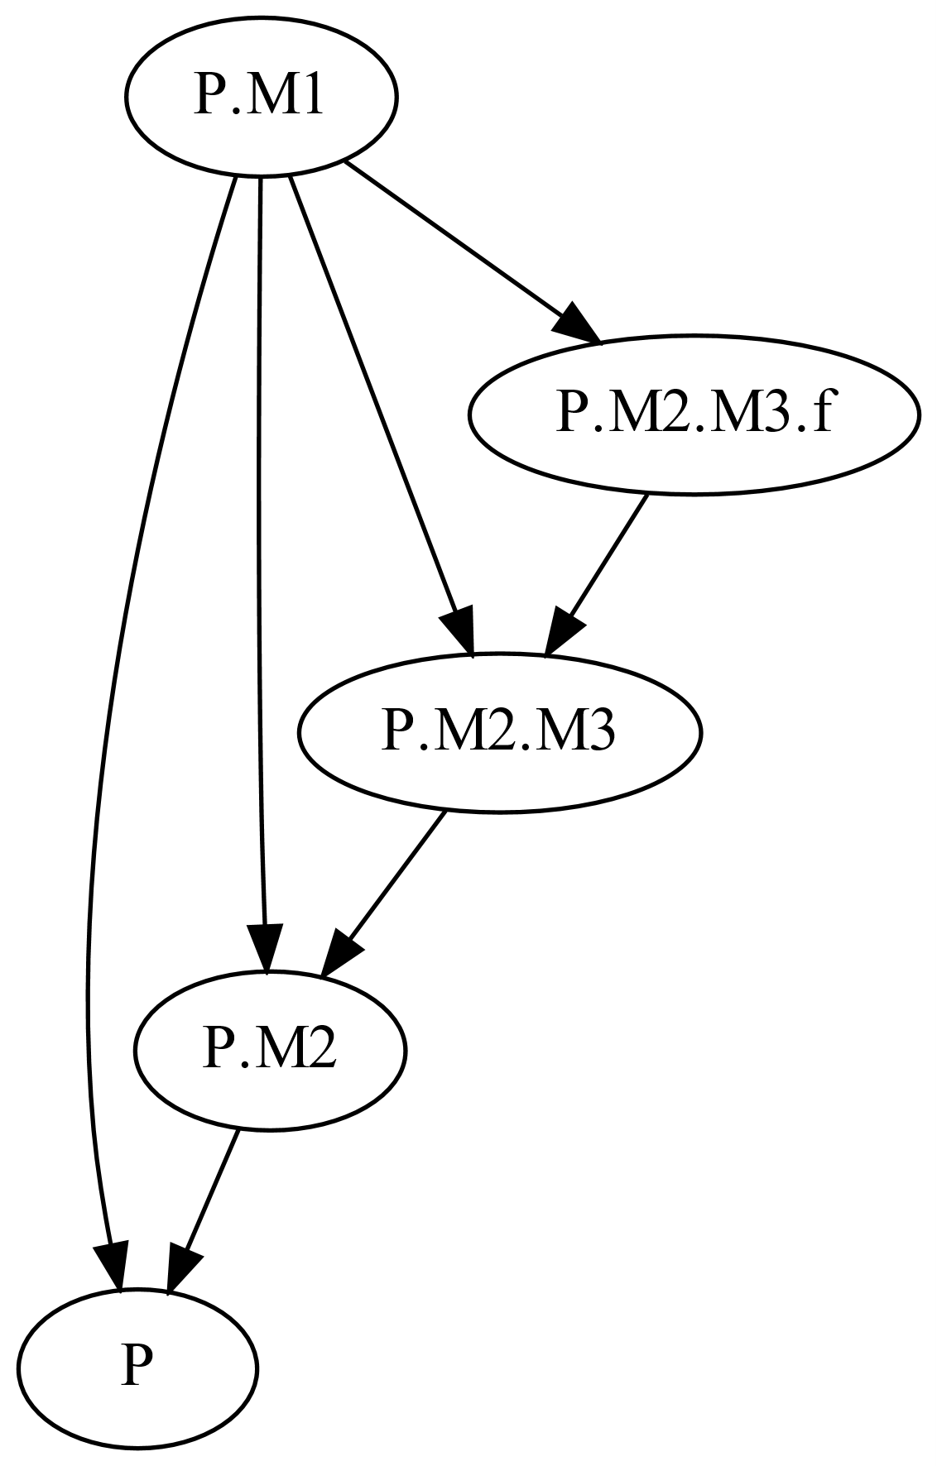
Dependency rule 4
4. A class depends on all classes enclosed by an accessed class.
package P
model M1
M2 m;
Real r = m.M3.f(1);
end M1;
model M2
model M3
function f
input Real x;
output Real y;
algorithm
y := x;
end f;
end M3;
end M2;
end P;
Notes:
Säg att regel 5 begränsar beroenden från denna regeln (blir många annars)

